Slide 1
Presentation on Credit EDA case study
By Archana Marwade

Slide 2
Purpose
This credit EDA case analysis will help to make a decision for loan approval based on the applicants profile, which control loss of business to the organization and avoid financial loss for that organization.

Slide 3
Steps Involved
Introduction of EDA case
Understanding of Dataset
Data imbalance and univariate and bivariate analysis, correlation
Merging of application with previous
Data analysis
Conclusion and Suggestion

Slide 4
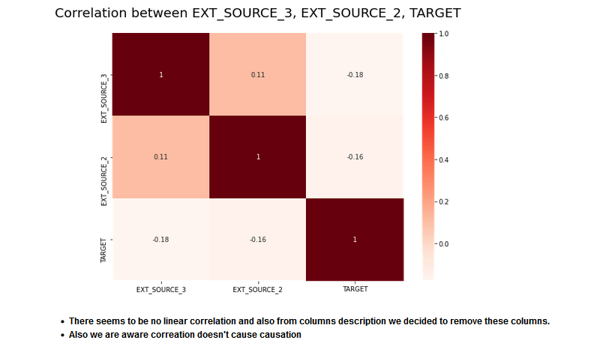

Slide 5
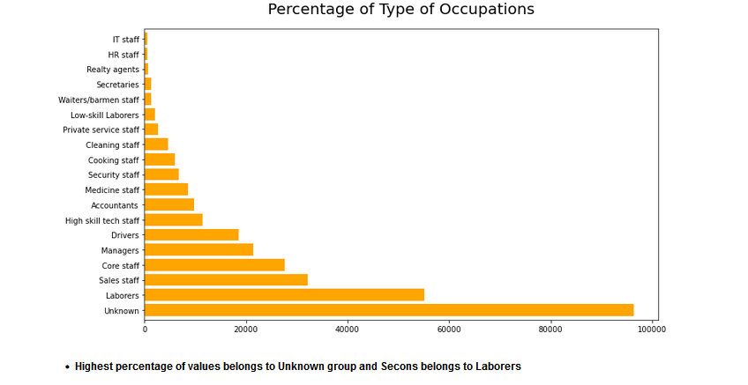

Slide 6
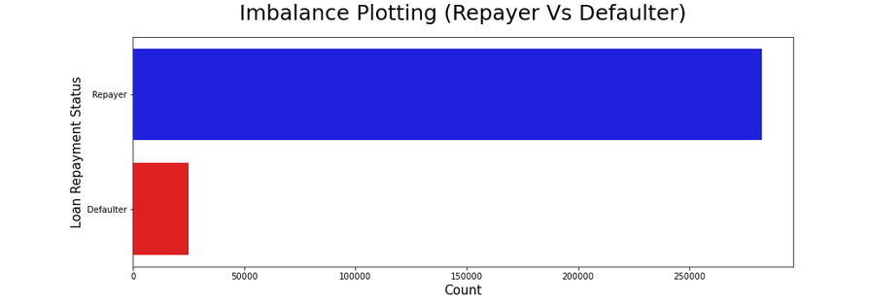

Slide 7
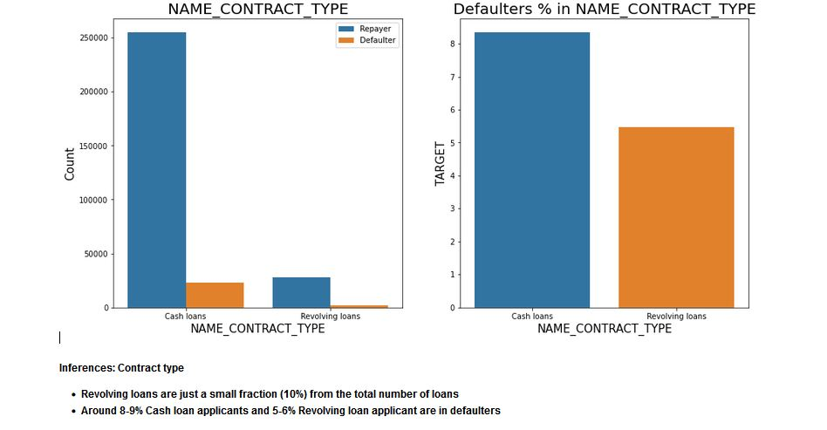

Slide 8
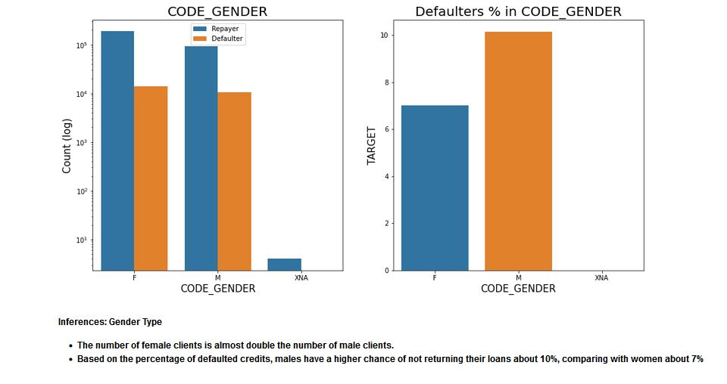

Slide 9
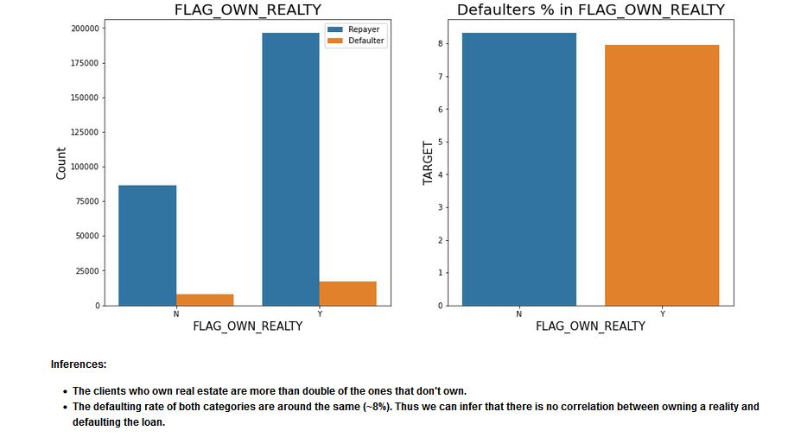

Slide 10
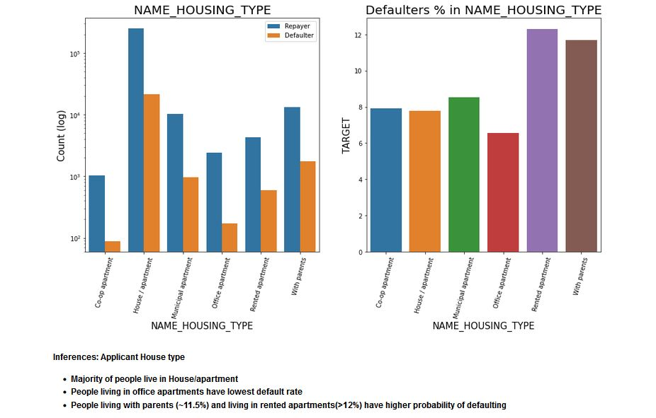

Slide 11
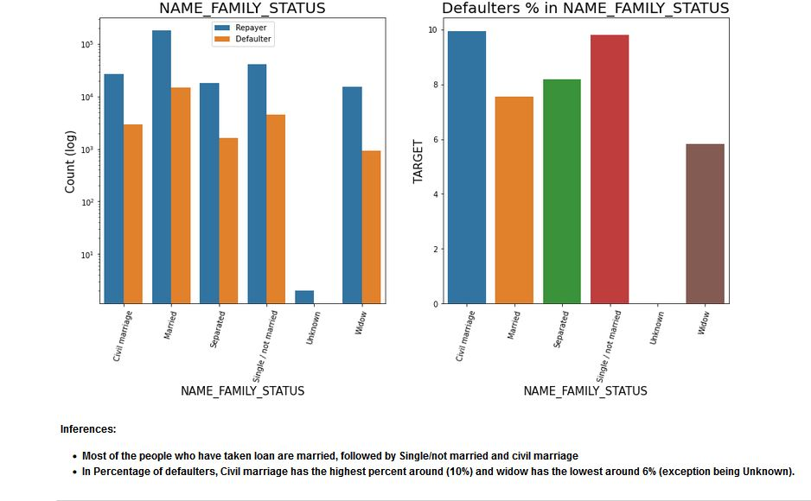

Slide 12
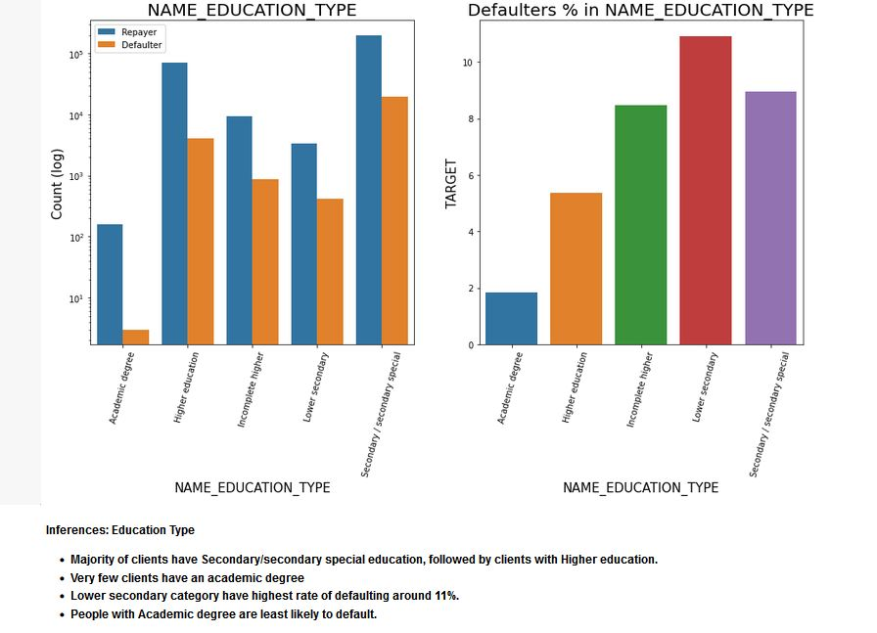

Slide 13
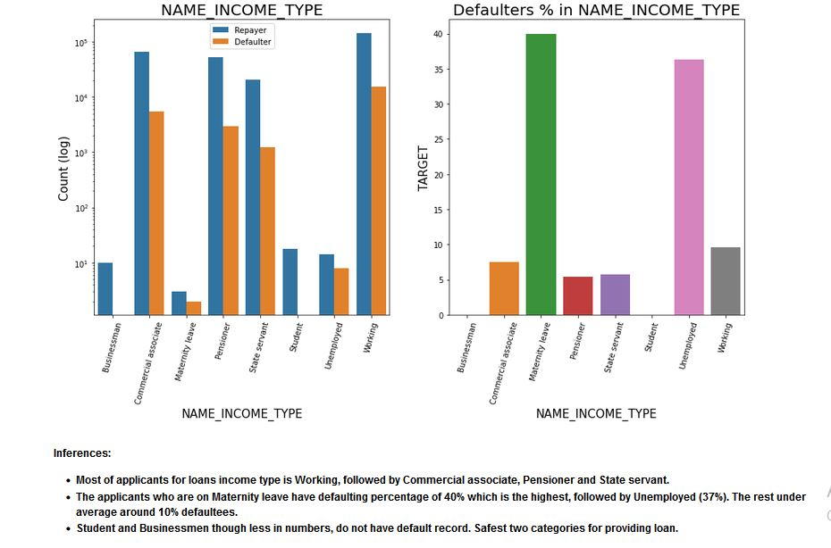

Slide 14
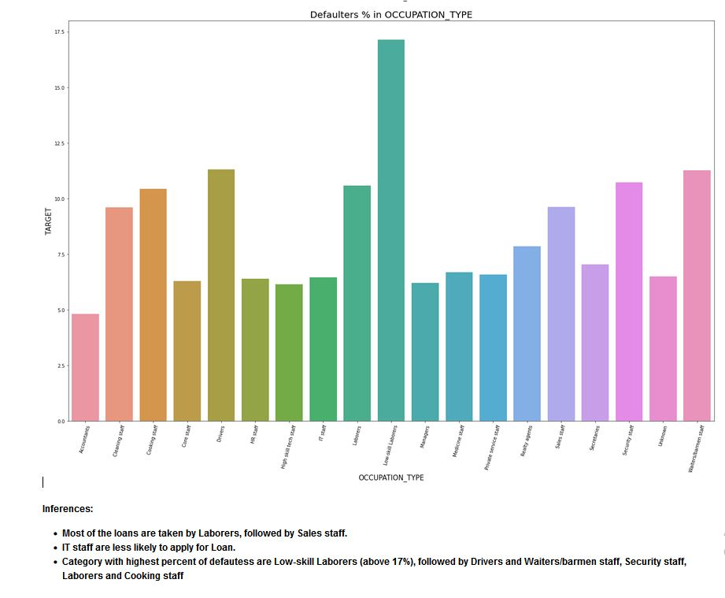

Slide 15
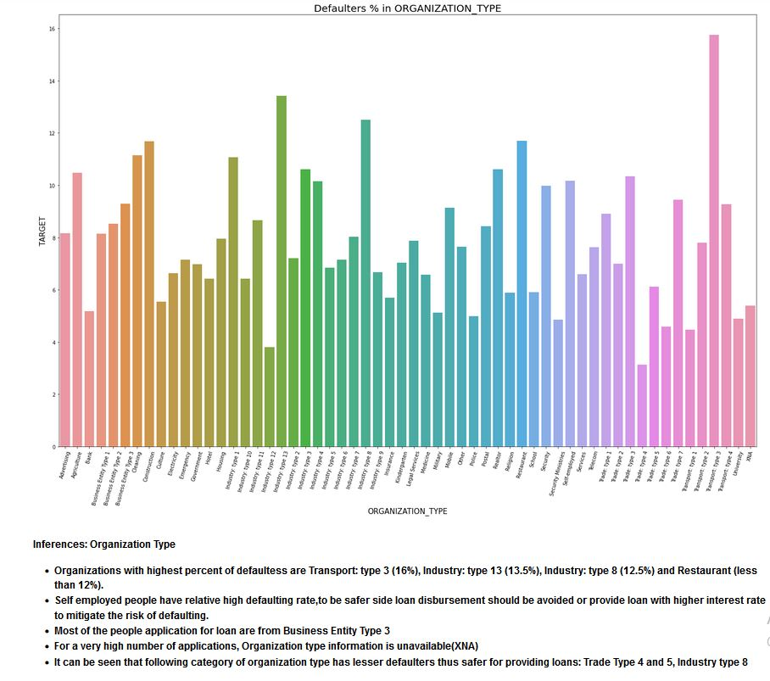

Slide 16
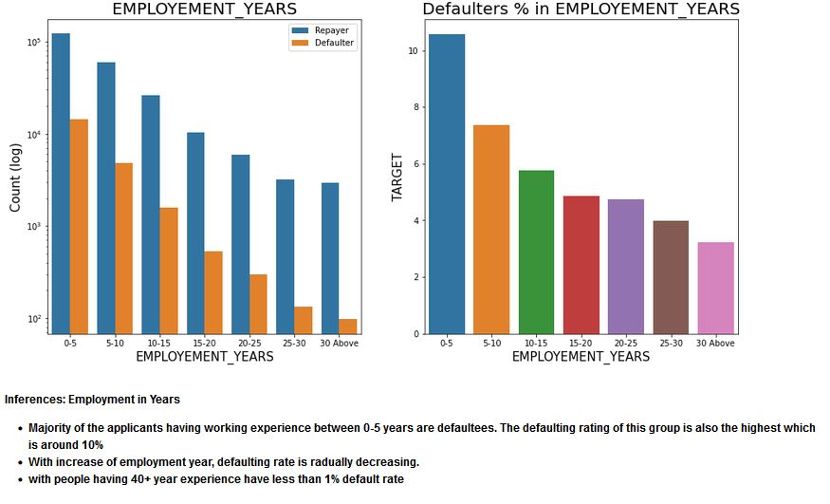

Slide 17
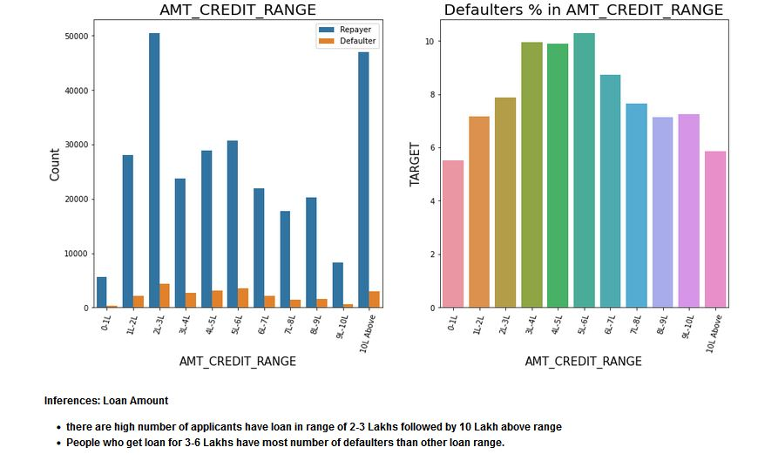

Slide 18
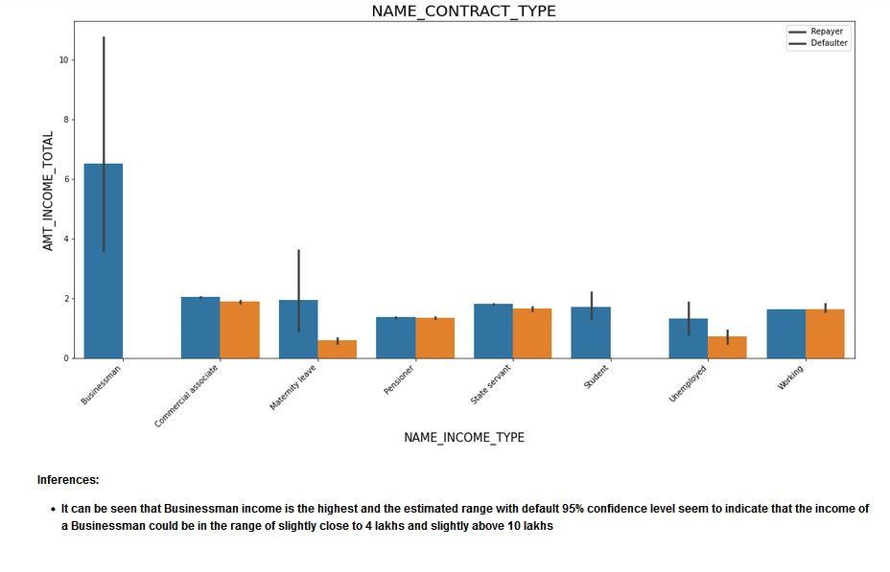

Slide 19
Decisive Factor whether an applicant will be Repayer
Academic degree has less defaults.
Student and Businessmen have no defaults.
Clients with Trade Type 4 and 5 and Industry type 8 have defaulted less than 3%
People above age of 50 have low probability of defaulting
Clients with 40+ year experience having less than 1% default rate
Applicant with Income more than 700,000 are less likely to default
Loans bought for Hobby, Buying garage are being repays mostly.
People with zero to two children tend to repay the loans.

Slide 20
Decisive Factor whether an applicant will be Defaulter:
Men are at relatively higher default rate
People who have civil marriage or who are single default a lot.
People with Lower Secondary & Secondary education
Clients who are either at Maternity leave OR Unemployed default a lot.
People who live in Rating 3 has highest defaults.
Avoid Low-skill Laborers, Drivers and Waiters/barmen staff, Security staff, Laborers and Cooking staff as their default rate is huge.
Organizations with highest percent of loans not repaid are Transport: type 3 (16%), Industry: type 13 (13.5%), Industry: type 8 (12.5%) and Restaurant (less than 12%). Self-employed people have relative high defaulting rate, and thus should be avoided to be approved for loan or provide loan with higher interest rate to mitigate the risk of defaulting.
young people who are in age group of 20-40 as they have higher probability of defaulting
People who have less than 5 years of employment have high default rate.
Client who have children equal to or more than 9 default 100% and hence their applications are to be rejected.
When the credit amount goes beyond 3lakhs, there is an increase in defaulters.

Slide 21
Suggestion
90% of the previously cancelled client have actually repayed the loan. Record the reason for cancellation which might help the bank to determine and negotiate terms with these repaying customers in future for increase business opportunity.

Slide 22
THANK YOU

